Slide 1
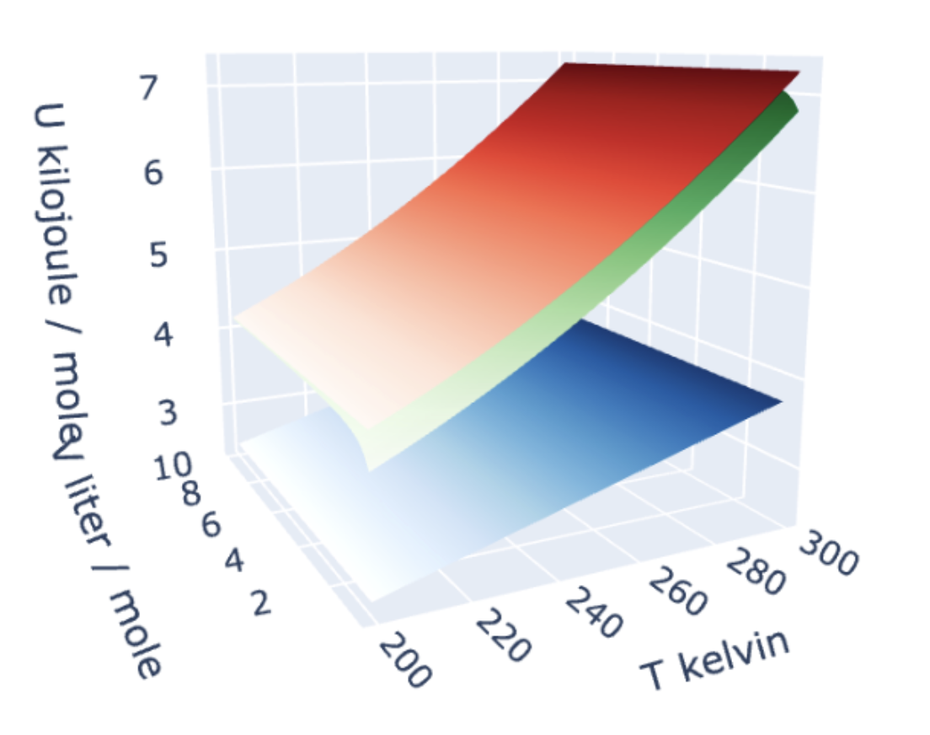
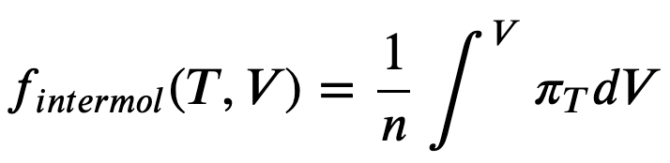
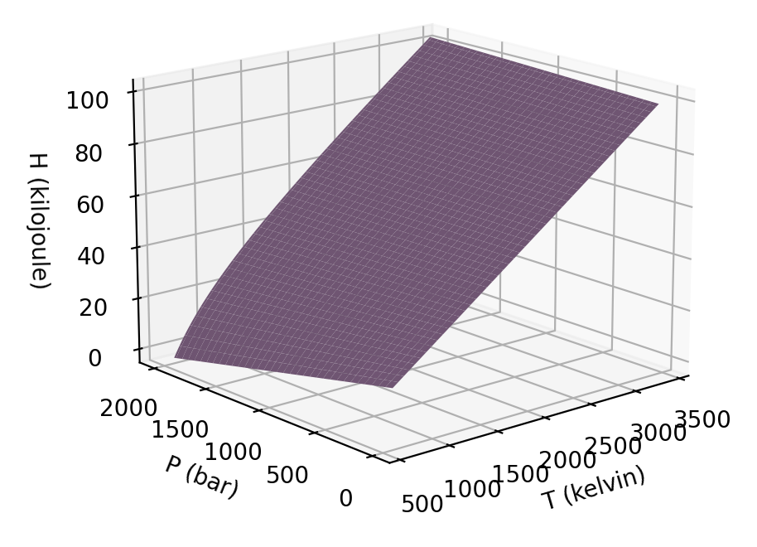
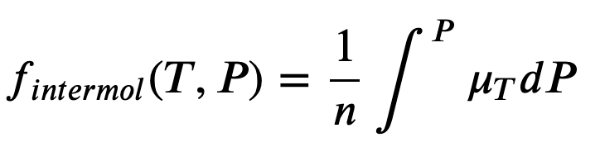
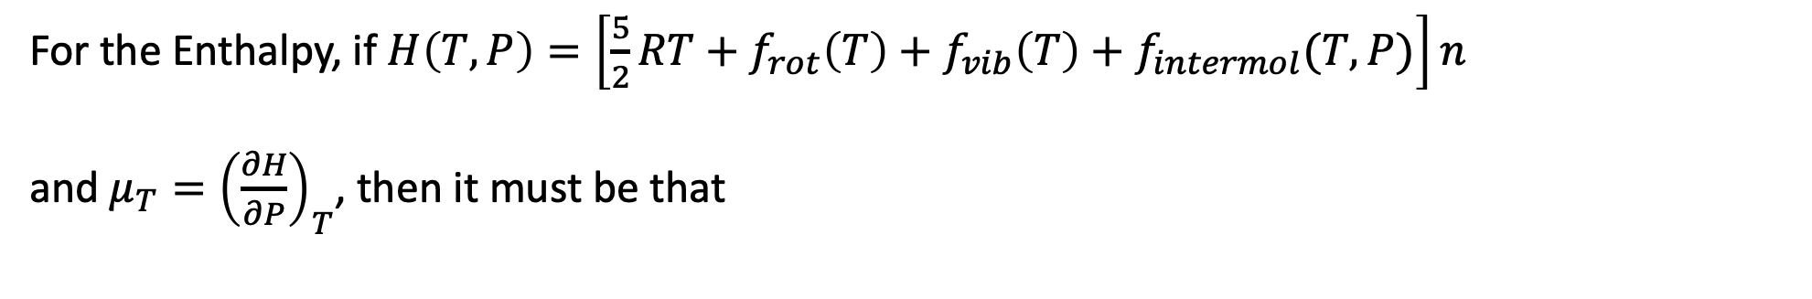
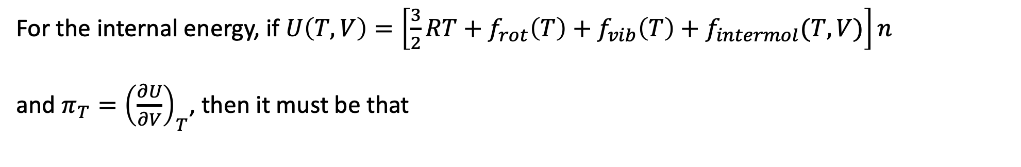
Recap of AnalyticalU&H
For the internal energy, if $U\left(T,V\right)=\left[\frac{3}{2}RT+f_{rot}\left(T\right)+f_{vib}\left(T\right)+f_{intermol}(T,V)\right]n$
and $π_{T}={\left(\frac{∂U}{∂V}\right)}_{T}$, then it must be that
For the Enthalpy, if $H\left(T,P\right)=\left[\frac{5}{2}RT+f_{rot}\left(T\right)+f_{vib}\left(T\right)+f_{intermol}(T,P)\right]n$
and $μ_{T}={\left(\frac{∂H}{∂P}\right)}_{T}$, then it must be that

Slide 2
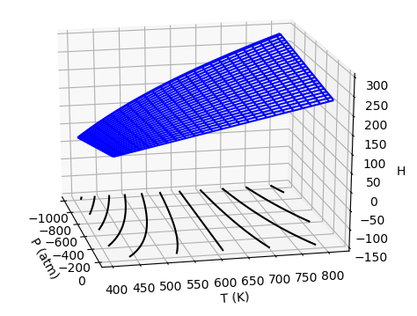
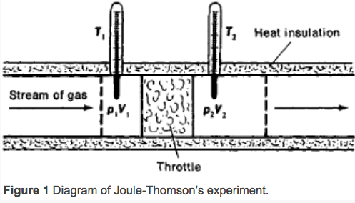



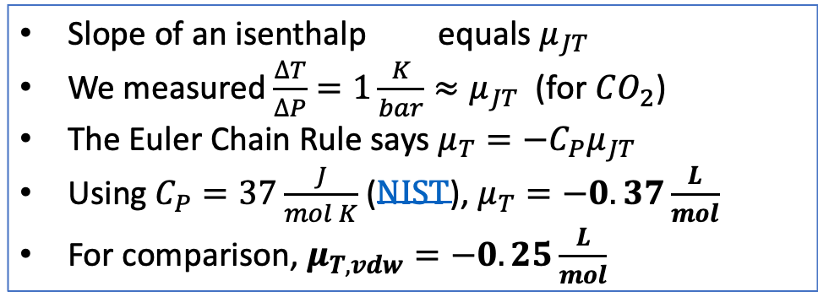
Recap: measuring $μ_{T}$ via the adiabatic Joule-Thomson experiment
A key feature of the Adiabatic Joule-Thomson experiment is that the gas follows an isenthalp (line of constant enthalpy) on its way out of the tank.
https://encyclopedia2.thefreedictionary.com/Joule-Thomson+Effect
$$∆P$$
Slope of an isenthalp equals $μ_{JT}$
We measured $\frac{∆T}{∆P}=1\frac{K}{bar}≈μ_{JT}$ (for $CO_{2}$)
The Euler Chain Rule says $μ_{T}=−C_{P}μ_{JT}$
Using $C_{P}=37\frac{J}{mol K}$ ($NIST$), $μ_{T}=−0.37\frac{L}{mol}$
For comparison, $μ_{T,vdw}=−0.25\frac{L}{mol}$
$$∆T$$

Slide 3
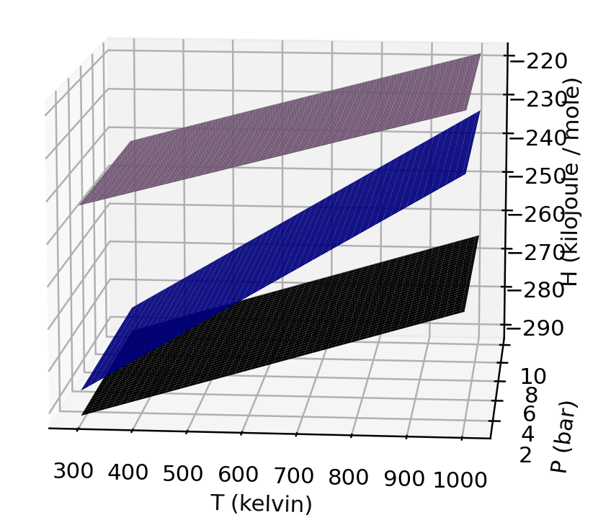
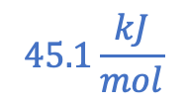
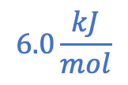
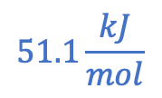
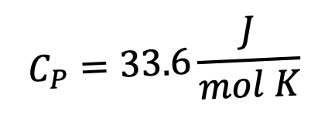

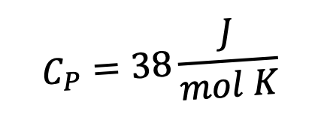



Recap: Expectations for $∆H_{rxn}$ at different temperatures
$$C_{P}=33.6\frac{J}{mol K}$$
$$ΔH_{vap}$$
H
$$C_{P}=75.4\frac{J}{mol K}$$
$$ΔH_{sub}$$
$$45.1\frac{kJ}{mol}$$
$$51.1\frac{kJ}{mol}$$
$$ΔH_{fus}$$
$$C_{P}=38\frac{J}{mol K}$$
$$6.0\frac{kJ}{mol}$$
273 K
T
At a given temperature and pressure, the enthalpy of sublimation equals the sum of the other two (but that is obviously not true if the three are taken at different temperatures or pressures)

Slide 4
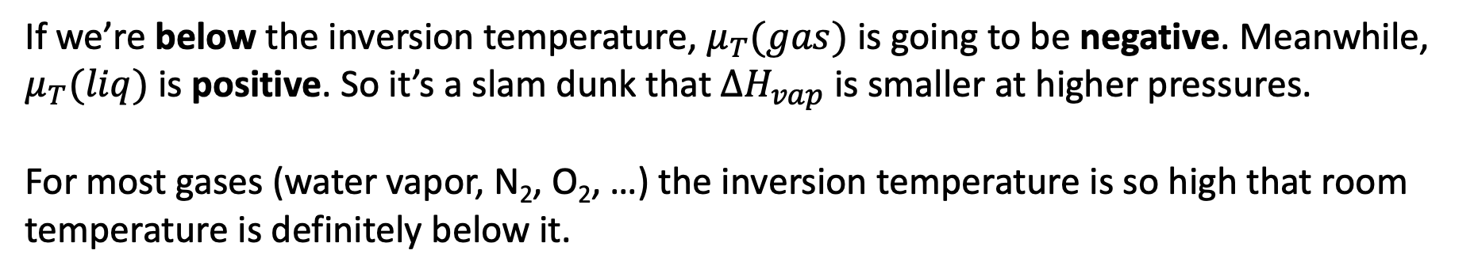
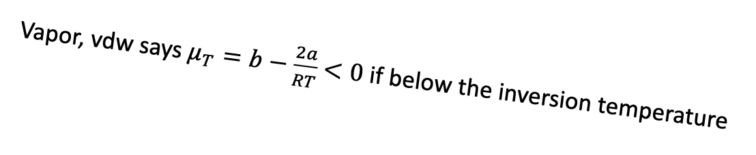
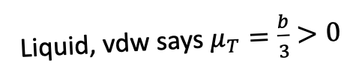
Recap: Expectations for $∆H_{rxn}$ at a pressure below the inversion temperature
Vapor, vdw says $μ_{T}=b−\frac{2a}{RT}$ $<0$ if below the inversion temperature
Liquid, vdw says $μ_{T}=\frac{b}{3}$ $>0$
B
A
P -->
B
A
If we’re below the inversion temperature, $μ_{T}(gas)$ is going to be negative. Meanwhile, $μ_{T}(liq)$ is positive. So it’s a slam dunk that $ΔH_{vap}$ is smaller at higher pressures.
For most gases (water vapor, N₂, O₂, …) the inversion temperature is so high that room temperature is definitely below it.

Slide 5
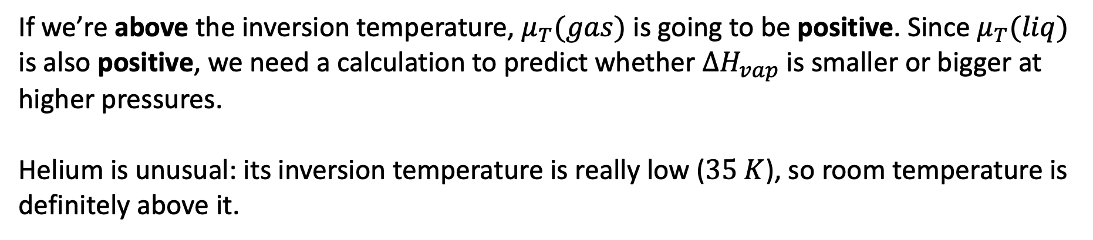
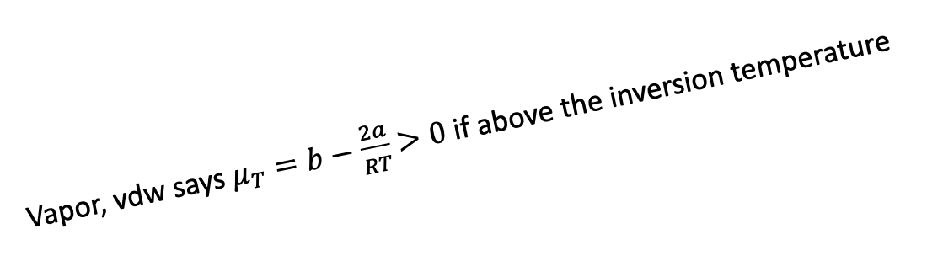
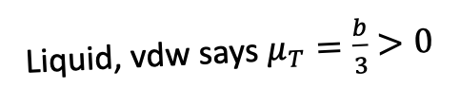
Recap: Expectations for $∆H_{rxn}$ at a pressure above the inversion temperature
Vapor, vdw says $μ_{T}=b−\frac{2a}{RT}$ $>0$ if above the inversion temperature
Liquid, vdw says $μ_{T}=\frac{b}{3}$ $>0$
B
A
P -->
B
A
If we’re above the inversion temperature, $μ_{T}(gas)$ is going to be positive. Since $μ_{T}(liq)$ is also positive, we need a calculation to predict whether $ΔH_{vap}$ is smaller or bigger at higher pressures.
Helium is unusual: its inversion temperature is really low ($35 K$), so room temperature is definitely above it.

Slide 6
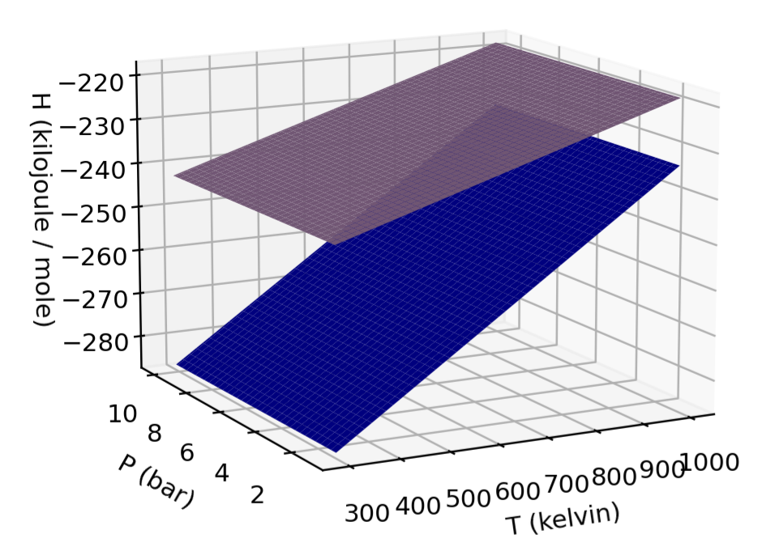
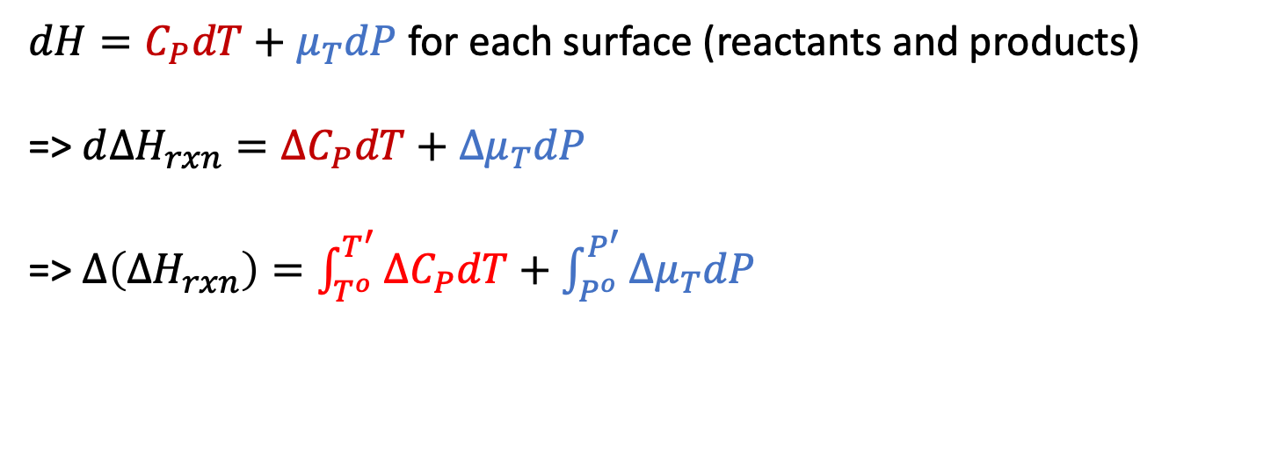




Recap: Quantitative predictions using $∆H_{rxn}=∆H_{rxn}^{o}+∆\left(∆H_{rxn}\right)$
$dH=C_{P}dT+μ_{T}dP$ for each surface (reactants and products)
=> $d∆H_{rxn}=∆C_{P}dT+{∆μ}_{T}dP$
=> $∆\left(∆H_{rxn}\right)=\int_{T^{o}}^{T^{′}}{{∆C}_{P}dT}+\int_{P^{o}}^{P^{′}}{{∆μ}_{T}dP}$
$${∆μ}_{T}=μ_{T}^{products}−μ_{T}^{reactants}$$
${∆C}_{P}=C_{P}^{products}−C_{P}^{reactants}$
$$products$$
$$reactants$$

Slide 7
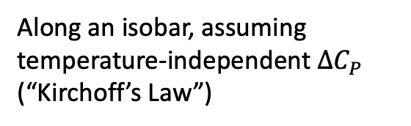
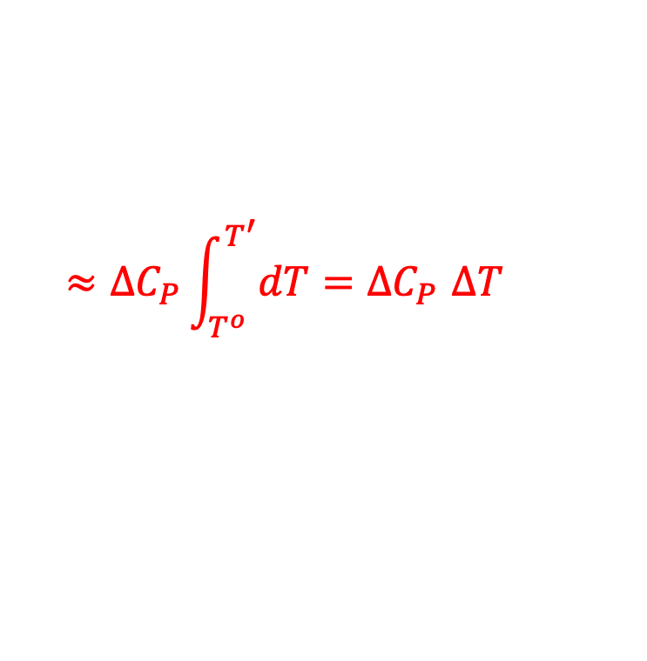
Recap: Quantitative predictions using $∆H_{rxn}=∆H_{rxn}^{o}+∆\left(∆H_{rxn}\right)$
$dH=C_{P}dT+μ_{T}dP$ for each surface (reactants and products)
=> $d∆H_{rxn}=∆C_{P}dT+{∆μ}_{T}dP$
=> $∆\left(∆H_{rxn}\right)=\int_{T^{o}}^{T^{′}}{{∆C}_{P}dT}+\int_{P^{o}}^{P^{′}}{{∆μ}_{T}dP}$
$${∆μ}_{T}=μ_{T}^{products}−μ_{T}^{reactants}$$
${∆C}_{P}=C_{P}^{products}−C_{P}^{reactants}$
$$products$$
Along an isobar, assuming temperature-independent ${∆C}_{P}$ (“Kirchoff’s Law”)
$$reactants$$
$$≈{∆C}_{P}\int_{T^{o}}^{T^{′}}{dT}{=∆C}_{P}∆T$$

Slide 8



Recap: Quantitative predictions using $∆H_{rxn}=∆H_{rxn}^{o}+∆\left(∆H_{rxn}\right)$
$dH=C_{P}dT+μ_{T}dP$ for each surface (reactants and products)
=> $d∆H_{rxn}=∆C_{P}dT+{∆μ}_{T}dP$
=> $∆\left(∆H_{rxn}\right)=\int_{T^{o}}^{T^{′}}{{∆C}_{P}dT}+\int_{P^{o}}^{P^{′}}{{∆μ}_{T}dP}$
$${∆μ}_{T}=μ_{T}^{products}−μ_{T}^{reactants}$$
${∆C}_{P}=C_{P}^{products}−C_{P}^{reactants}$
$$products$$
Since vdw gives us simple expressions for $μ_{T}$, we can often do this integral exactly.
$$reactants$$

Slide 9
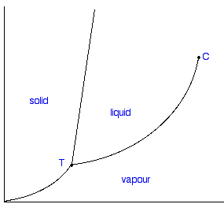
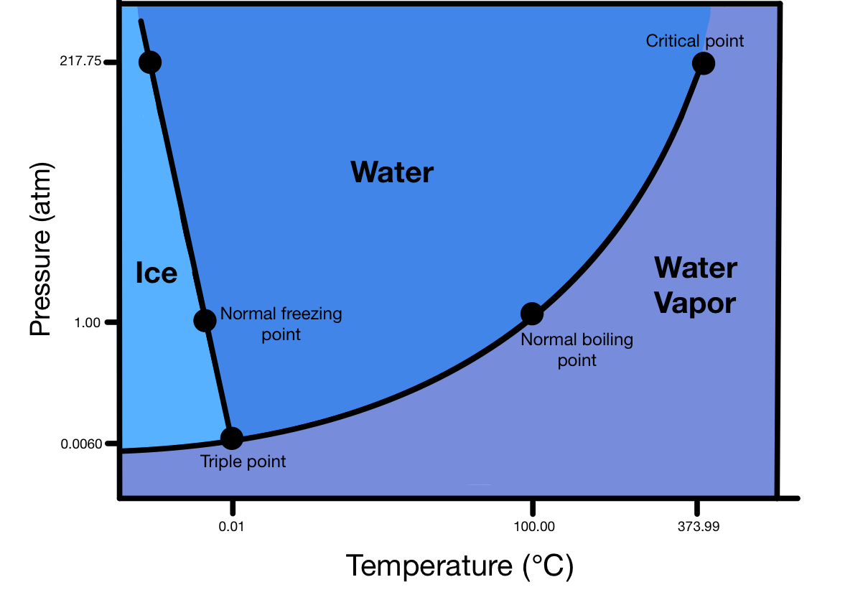
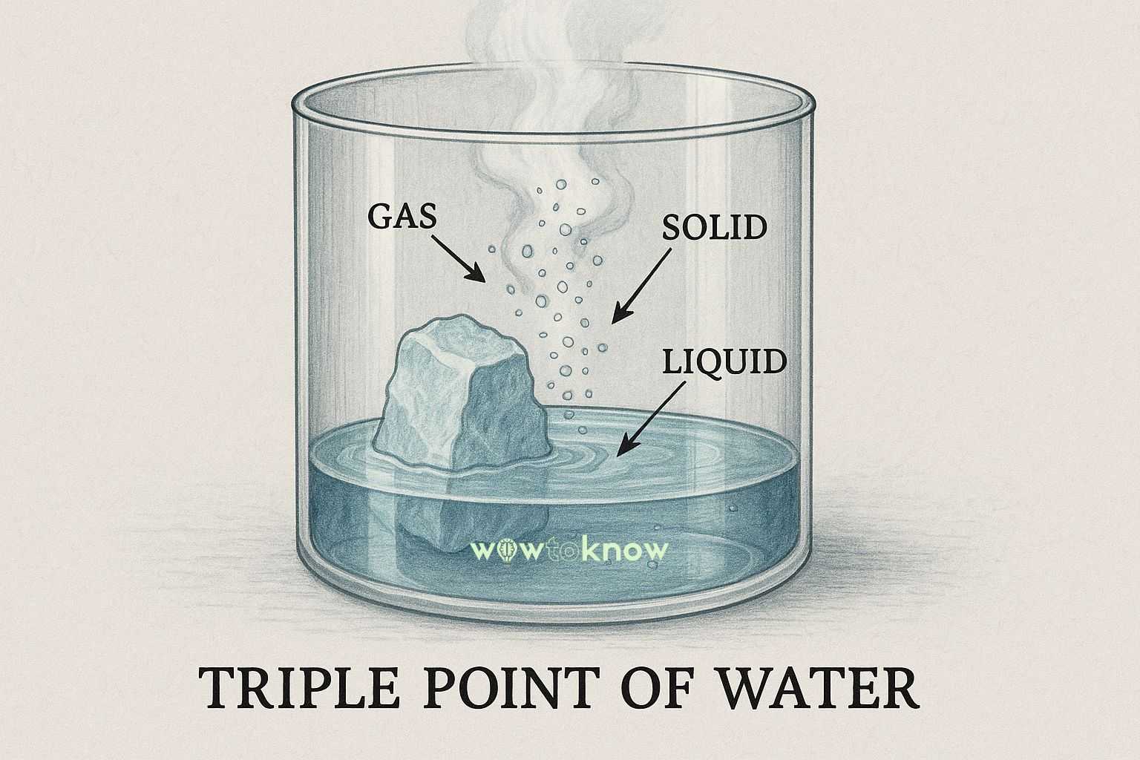




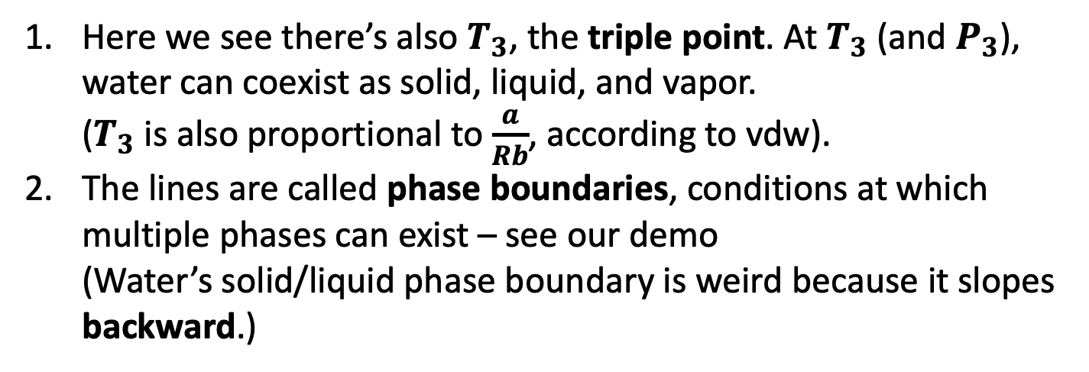





Recap (and a demo): phase diagrams
This is a typical phase diagram
This is the phase diagram of water
$$P_{3}$$
$$P_{3}$$
$$T_{3}$$
$$T_{crit}$$
$$T_{3}$$
$$T_{crit}$$
$$T_{Boyle}$$
$$T_{I}$$
Here we see there’s also $T_{3}$, the triple point. At $T_{3}$ (and $P_{3}$), water can coexist as solid, liquid, and vapor.
($T_{3}$ is also proportional to $\frac{a}{Rb}$, according to vdw).
The lines are called phase boundaries, conditions at which multiple phases can exist – see our demo
(Water’s solid/liquid phase boundary is weird because it slopes backward.)

Slide 10

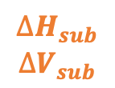
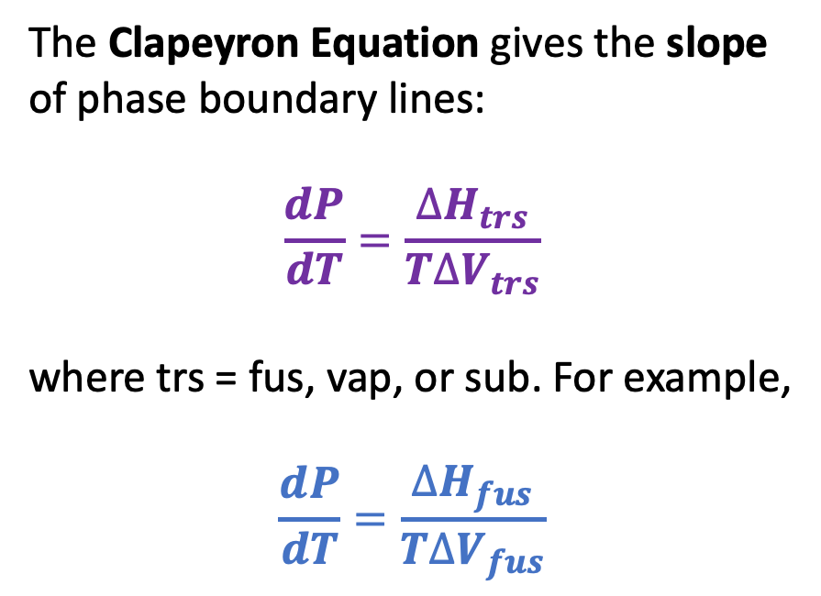
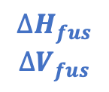

New today: the Clapeyron equation
The Clapeyron Equation gives the slope of phase boundary lines:
$$\frac{dP}{dT}=\frac{∆H_{trs}}{T∆V_{trs}}$$
where trs = fus, vap, or sub. For example,
$$\frac{dP}{dT}=\frac{∆H_{fus}}{T∆V_{fus}}$$
$$∆H_{fus}$$
$$∆V_{fus}$$
$$∆H_{vap}$$
$$∆V_{vap}$$
$$∆H_{vap}$$
$$∆V_{vap}$$
$$∆H_{sub}$$
$$∆V_{sub}$$
We’ll derive the Clapeyron equation later. For now we’ll just use it to obtain expressions for the phase boundary lines themselves – by integrating the slope.

Slide 11
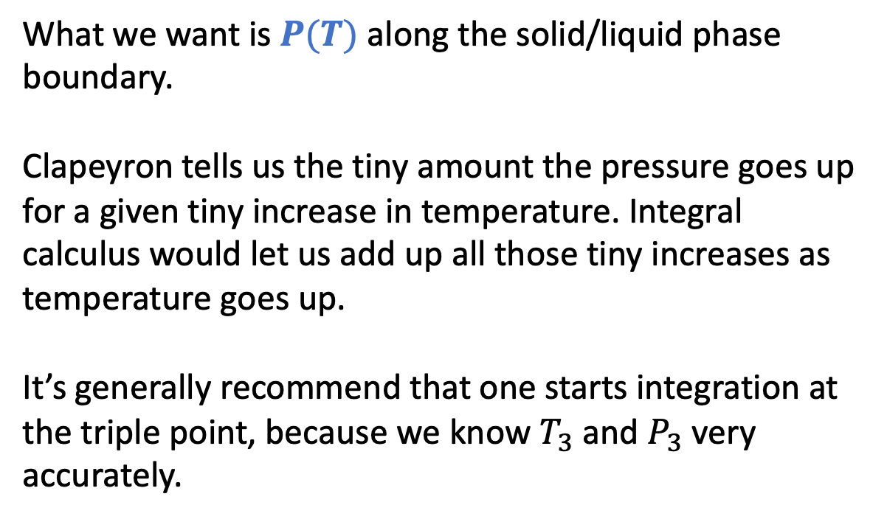
Blackboard work: getting an expression for the blue line by integral calculus
What we want is $P(T)$ along the solid/liquid phase boundary.
Clapeyron tells us the tiny amount the pressure goes up for a given tiny increase in temperature. Integral calculus would let us add up all those tiny increases as temperature goes up.
It’s generally recommend that one starts integration at the triple point, because we know $T_{3}$ and $P_{3}$ very accurately.
P
T

Slide 12
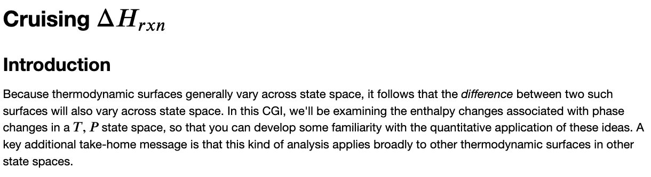
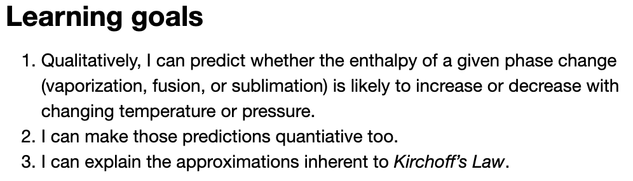
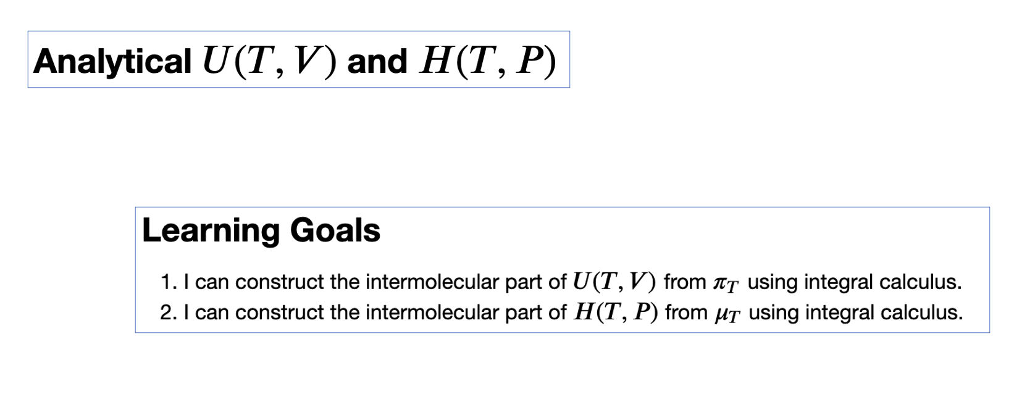
Wrapping up the Python work

